Slide 1
12-Factor App
12-Factor App is used widely in Microservices Architecture. It is a set of 12 best practices to build cloud-native applications and understanding them is vital for any developer to design and build a cloud-native / microservices application.

Slide 2
What Is the Twelve-Factor Methodology?
The twelve-factor methodology is a set of twelve best practices to develop applications developed to run as a service.
This was originally drafted by Heroku for applications deployed as services on their cloud platform, back in 2011.
Over time, this has proved to be generic enough for any software-as-a-service (SaaS) development.

Slide 3
What Is the Twelve-Factor Methodology?
In the modern era, software is commonly delivered as a service: called web apps, or software-as-a-service. The twelve-factor app is a methodology for building software-as-a-service apps that:
Use declarative formats for setup automation, to minimize time and cost for new developers joining the project;
Have a clean contract with the underlying operating system, offering maximum portability between execution environments;
Are suitable for deployment on modern cloud platforms, obviating the need for servers and systems administration;
Minimize divergence between development and production, enabling continuous deployment for maximum agility;
And can scale up without significant changes to tooling, architecture, or development practices.
The twelve-factor methodology can be applied to apps written in any programming language, and which use any combination of backing services (database, queue, memory cache, etc).

Slide 4
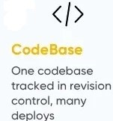
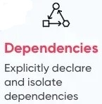
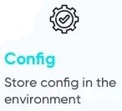
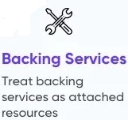
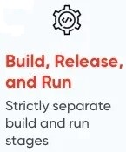
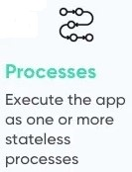

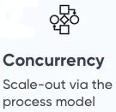
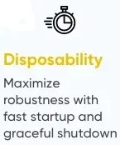
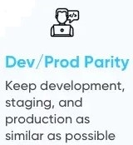
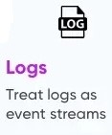
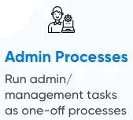
The Twelve Factors

Slide 5
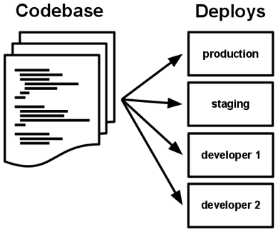
1. Codebase
One codebase tracked in revision control, many deploys
A twelve-factor app is always tracked in a version control system, such as Git, Mercurial, or Subversion. A copy of the revision tracking database is known as a code repository, often shortened to code repo or just repo.
A codebase is any single repo (in a centralized revision control system like Subversion), or any set of repos who share a root commit (in a decentralized revision control system like Git).

Slide 6
1. Codebase
There is always a one-to-one correlation between the codebase and the app:
If there are multiple codebases, it’s not an app – it’s a distributed system. Each component in a distributed system is an app, and each can individually comply with twelve-factor.
Multiple apps sharing the same code is a violation of twelve-factor. The solution here is to factor shared code into libraries which can be included through the dependency manager.
There is only one codebase per app, but there will be many deploys of the app.
A deploy is a running instance of the app.
This is typically a production site, and one or more staging sites.
Additionally, every developer has a copy of the app running in their local development environment, each of which also qualifies as a deploy.
The codebase is the same across all deploys, although different versions may be active in each deploy.

Slide 7
2. Dependencies
Explicitly declare and isolate dependencies
Most programming languages offer a packaging system for distributing support libraries, such as CPAN for Perl or Rubygems for Ruby.
Libraries installed through a packaging system can be installed system-wide (known as “site packages”) or scoped into the directory containing the app (known as “vendoring” or “bundling”).
A twelve-factor app never relies on implicit existence of system-wide packages.
It declares all dependencies, completely and exactly, via a dependency declaration manifest.
Furthermore, it uses a dependency isolation tool during execution to ensure that no implicit dependencies “leak in” from the surrounding system.
The full and explicit dependency specification is applied uniformly to both production and development.

Slide 8
3. Config
Store config in the environment
An app’s config is everything that is likely to vary between deploys (staging, production, developer environments, etc). This includes:
Resource handles to the database, Memcached, and other backing services
Credentials to external services such as Amazon S3 or Twitter
Per-deploy values such as the canonical hostname for the deploy
Apps sometimes store config as constants in the code.
This is a violation of twelve-factor, which requires strict separation of config from code. Config varies substantially across deploys, code does not.
A litmus test for whether an app has all config correctly factored out of the code is whether the codebase could be made open source at any moment, without compromising any credentials.

Slide 9
3. Config
The twelve-factor app stores config in environment variables (often shortened to env vars or env).
Env vars are easy to change between deploys without changing any code; unlike config files, there is little chance of them being checked into the code repo accidentally; and unlike custom config files, or other config mechanisms such as Java System Properties, they are a language- and OS-agnostic standard.
In a twelve-factor app, env vars are granular controls, each fully orthogonal to other env vars. They are never grouped together as “environments”, but instead are independently managed for each deploy.

Slide 10
4. Backing services
Treat backing services as attached resources
A backing service is any service the app consumes over the network as part of its normal operation.
Examples include datastores (such as MySQL or CouchDB), messaging/queueing systems (such as RabbitMQ or Beanstalkd), SMTP services for outbound email (such as Postfix), and caching systems (such as Memcached).
Backing services like the database are traditionally managed by the same systems administrators who deploy the app’s runtime.
The code for a twelve-factor app makes no distinction between local and third party services.
To the app, both are attached resources, accessed via a URL or other locator/credentials stored in the config.
A deploy of the twelve-factor app should be able to swap out a local MySQL database with one managed by a third party (such as Amazon RDS) without any changes to the app’s code.

Slide 11
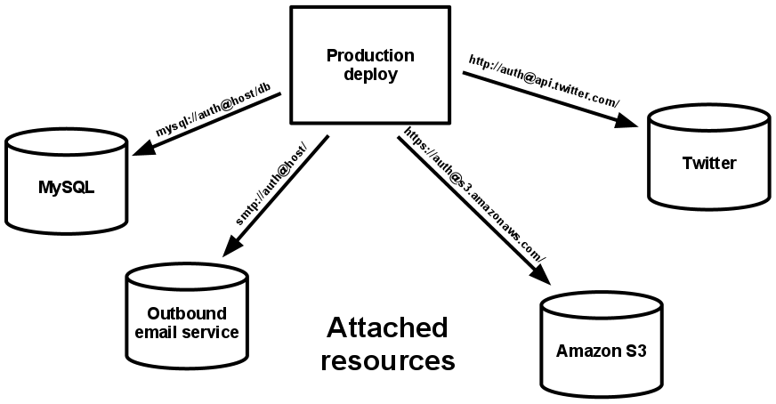
4. Backing services
Each distinct backing service is a resource.
For example, a MySQL database is a resource; two MySQL databases (used for sharding at the application layer) qualify as two distinct resources.
The twelve-factor app treats these databases as attached resources, which indicates their loose coupling to the deploy they are attached to.
Resources can be attached to and detached from deploys at will.
For example, if the app’s database is misbehaving due to a hardware issue, the app’s administrator might spin up a new database server restored from a recent backup.

Slide 12
5. Build, release, run
Strictly separate build and run stages
A codebase is transformed into a (non-development) deploy through three stages:
The build stage is a transform which converts a code repo into an executable bundle known as a build. Using a version of the code at a commit specified by the deployment process, the build stage fetches vendors dependencies and compiles binaries and assets.
The release stage takes the build produced by the build stage and combines it with the deploy’s current config. The resulting release contains both the build and the config and is ready for immediate execution in the execution environment.
The run stage (also known as “runtime”) runs the app in the execution environment, by launching some set of the app’s processes against a selected release.

Slide 13
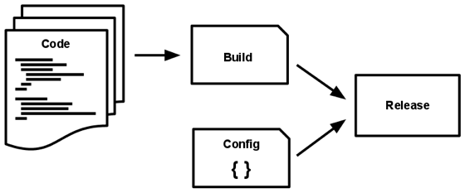
5. Build, release, run
The twelve-factor app uses strict separation between the build, release, and run stages.
For example, it is impossible to make changes to the code at runtime, since there is no way to propagate those changes back to the build stage.
Deployment tools typically offer release management tools, most notably the ability to roll back to a previous release.
Every release should always have a unique release ID, such as a timestamp of the release (such as 2011-04-06-20:32:17) or an incrementing number (such as v100).
Releases are an append-only ledger and a release cannot be mutated once it is created. Any change must create a new release.

Slide 14
6. Processes
Execute the app as one or more stateless processes
The app is executed in the execution environment as one or more processes.
In the simplest case, the code is a stand-alone script, the execution environment is a developer’s local laptop with an installed language runtime, and the process is launched via the command line (for example, python my_script.py).
On the other end of the spectrum, a production deploy of a sophisticated app may use many process types, instantiated into zero or more running processes.
Twelve-factor processes are stateless and share-nothing.
Any data that needs to persist must be stored in a stateful backing service, typically a database.
The memory space or filesystem of the process can be used as a brief, single-transaction cache.

Slide 15
7. Port binding
Export services via port binding
Web apps are sometimes executed inside a webserver container.
For example, PHP apps might run as a module inside Apache HTTPD, or Java apps might run inside Tomcat.
The twelve-factor app is completely self-contained and does not rely on runtime injection of a webserver into the execution environment to create a web-facing service.
The web app exports HTTP as a service by binding to a port, and listening to requests coming in on that port.

Slide 16
8. Concurrency
Scale out via the process model
Any computer program, once run, is represented by one or more processes. Web apps have taken a variety of process-execution forms.
For example, PHP processes run as child processes of Apache, started on demand as needed by request volume.
Java processes take the opposite approach, with the JVM providing one massive uberprocess that reserves a large block of system resources (CPU and memory) on startup, with concurrency managed internally via threads.
In both cases, the running process(es) are only minimally visible to the developers of the app.

Slide 17
8. Concurrency
In the twelve-factor app, processes are a first class citizen.
Processes in the twelve-factor app take strong cues from the unix process model for running service daemons.
Using this model, the developer can architect their app to handle diverse workloads by assigning each type of work to a process type.
For example, HTTP requests may be handled by a web process, and long-running background tasks handled by a worker process.
This does not exclude individual processes from handling their own internal multiplexing, via threads inside the runtime VM, or the async/evented model found in tools such as EventMachine, Twisted, or Node.js. But an individual VM can only grow so large (vertical scale), so the application must also be able to span multiple processes running on multiple physical machines.

Slide 18
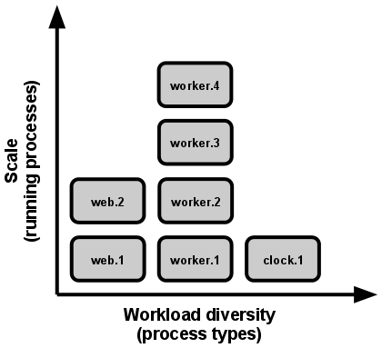
8. Concurrency
The process model truly shines when it comes time to scale out.
The share-nothing, horizontally partitionable nature of twelve-factor app processes means that adding more concurrency is a simple and reliable operation.
The array of process types and number of processes of each type is known as the process formation.
Twelve-factor app processes should never daemonize or write PID files.
Instead, rely on the operating system’s process manager (such as systemd, a distributed process manager on a cloud platform, or a tool like Foreman in development) to manage output streams, respond to crashed processes, and handle user-initiated restarts and shutdowns.

Slide 19
9. Disposability
Maximize robustness with fast startup and graceful shutdown
The twelve-factor app’s processes are disposable, meaning they can be started or stopped at a moment’s notice.
This facilitates fast elastic scaling, rapid deployment of code or config changes, and robustness of production deploys.
Processes should strive to minimize startup time. Ideally, a process takes a few seconds from the time the launch command is executed until the process is up and ready to receive requests or jobs.
Short startup time provides more agility for the release process and scaling up; and it aids robustness, because the process manager can more easily move processes to new physical machines when warranted.

Slide 20
9. Disposability
Processes shut down gracefully when they receive a SIGTERM signal from the process manager.
For a web process, graceful shutdown is achieved by ceasing to listen on the service port (thereby refusing any new requests), allowing any current requests to finish, and then exiting.
Processes should also be robust against sudden death, in the case of a failure in the underlying hardware.
While this is a much less common occurrence than a graceful shutdown with SIGTERM, it can still happen.
A twelve-factor app is architected to handle unexpected, non-graceful terminations.

Slide 21
10. Dev/prod parity
Keep development, staging, and production as similar as possible
Historically, there have been substantial gaps between development (a developer making live edits to a local deploy of the app) and production (a running deploy of the app accessed by end users).
These gaps manifest in three areas:
The time gap: A developer may work on code that takes days, weeks, or even months to go into production.
The personnel gap: Developers write code, ops engineers deploy it.
The tools gap: Developers may be using a stack like Nginx, SQLite, and OS X, while the production deploy uses Apache, MySQL, and Linux.

Slide 22
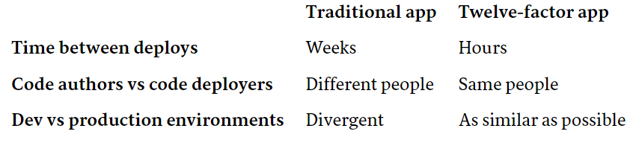
10. Dev/prod parity
The twelve-factor app is designed for continuous deployment by keeping the gap between development and production small.
Looking at the three gaps described above:
Make the time gap small: a developer may write code and have it deployed hours or even just minutes later.
Make the personnel gap small: developers who wrote code are closely involved in deploying it and watching its behavior in production.
Make the tools gap small: keep development and production as similar as possible.

Slide 23
11. Logs
Treat logs as event streams
Logs provide visibility into the behavior of a running app. In server-based environments they are commonly written to a file on disk (a “logfile”); but this is only an output format.
Logs are the stream of aggregated, time-ordered events collected from the output streams of all running processes and backing services.
Logs in their raw form are typically a text format with one event per line (though backtraces from exceptions may span multiple lines).
Logs have no fixed beginning or end, but flow continuously as long as the app is operating.
A twelve-factor app never concerns itself with routing or storage of its output stream.
It should not attempt to write to or manage logfiles.

Slide 24
12. Admin processes
Run admin/management tasks as one-off processes
The process formation is the array of processes that are used to do the app’s regular business (such as handling web requests) as it runs.
Separately, developers will often wish to do one-off administrative or maintenance tasks for the app, such as:
Running database migrations.
Running a console to run arbitrary code or inspect the app’s models against the live database.
Running one-time scripts committed into the app’s repo

Slide 25
12. Admin processes
Twelve-factor strongly favors languages which provide a REPL (Read Evaluate Print Loop) shell out of the box, and which make it easy to run one-off scripts.
In a local deploy, developers invoke one-off admin processes by a direct shell command inside the app’s checkout directory.
In a production deploy, developers can use ssh or other remote command execution mechanism provided by that deploy’s execution environment to run such a process.

